Slide 1
Ako, Ikaw, at ang Gobyerno

Slide 2
Compass

Slide 3
Control

Slide 4
Constant

Slide 5
Conscience

Slide 6
Core

Slide 7
Situating our LGU Accountants in Excellent Local Governance
Office of the Assistant Secretary for Local Government
Department of the Interior and Local Government

Slide 8
Governance Framework
POLITICS
+
ECONOMICS
=
GOVERNANCE

Slide 9
Duties of LG Accountants Under the LG Code
(1) Install and maintain an internal audit system in the local government unit concerned;
(2) Prepare and submit financial statements to the governor or mayor, as the case may be, and to the sanggunian concerned;
(3) Appraise the sanggunian and other local government officials on the financial condition and operations of the local government unit concerned;
(4) Certify to the availability of budgetary allotment to which expenditures and obligations may be properly charged;
(5) Review supporting documents before preparation of vouchers to determine completeness of requirements;
(6) Prepare statements of cash advances, liquidation, salaries, allowances, reimbursements and remittances pertaining to the local government unit;
(7) Prepare statements of journal vouchers and liquidation of the same and other adjustments related thereto;
(8) Post individual disbursements to the subsidiary ledger and index cards;
(9) Maintain individual ledgers for officials and employees of the local government unit pertaining to payrolls and deductions;
(10) Record and post in index cards details of purchased furniture, fixtures, and equipment, including disposal thereof, if any;
(11) Account for all issued requests for obligations and maintain and keep all records and reports related thereto;
(12) Prepare journals and the analysis of obligations and maintain and keep all records and reports related thereto; and
(13) Exercise such other powers and perform such other duties and functions as may be provided by law or ordinance.
Section 474, RA 7160

Slide 10
Nexus of Fiscal Management and Good Governance
“Local planning and budgeting is a systematic and logical process of collecting and validating data to serve as the basis in identifying necessary interventions to attain local government visions and which should be continuously reviewed and improved. Facilitation of this requires that local plans be embodied in local budgets for responsive public services.”
Sicat, et al., Assessment of the Philippine Local Government Planning and Budgeting Framework, Philippine Institute of Development Studies (PIDS) (2019)

Slide 11
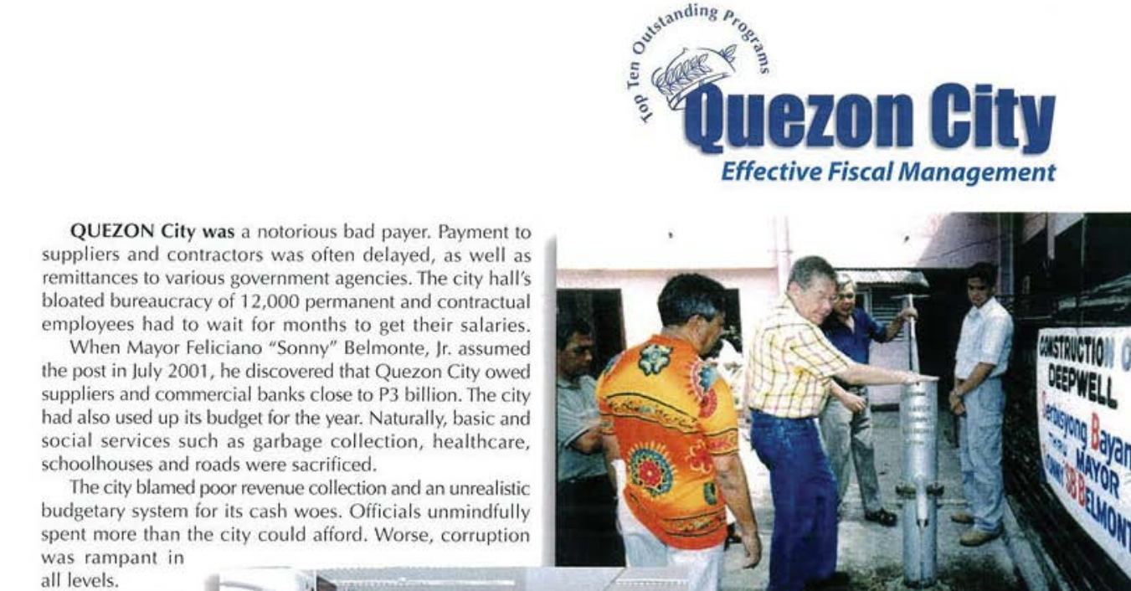
Nexus of Fiscal Management and Good Governance
“Expenditures have to be needs-driven, not supplier driven, not kumpare-driven.”
Quezon City, 2003 Galing Pook Awardee for Effective Fiscal Management
From P600,000 in deficit to P2.2 billion in budget surplus in three years

Slide 12



Pillars of Sound Local Fiscal Management
Diligence
Transparency
Synergy
Ensuring public funds
are accounted for and
spent according to needs
Institutionalizing mechanisms
to communicate information
to stakeholders
Working with other
units and organizations
toward a common goal

Slide 13

Seal of Good Local Governance
Good fiscal administration is when the LGU demonstrates positive and stable economic performance, and maintains, preserves and mandatorily upholds the practices of fiscal discipline, sustainability, accountability and transparency, by adhering to pertinent budgeting laws, rules, and best practices in public financial management.
RA 11292 Implementing Rules and Regulations

Slide 14
Seal of Good Local Governance
Compliance with full disclosure policy (FDP) requirements
Development Fund utilization
Unmodified or qualified COA opinion
Timely approval of local budget
At least 30% of COA recommendations fully complied with
Positive increase in average local revenue growth

Slide 15

SubayBayani
SubayBayani is a recognition given to excellent and consistent performers in the conduct of monitoring of LGU projects under the SubayBayan portal.
It is given to exemplary members of regional and local Project Monitoring Committees (PMCs) which are tasked to prepare periodic monitoring reports on the status of LGU project implementation.

Slide 16
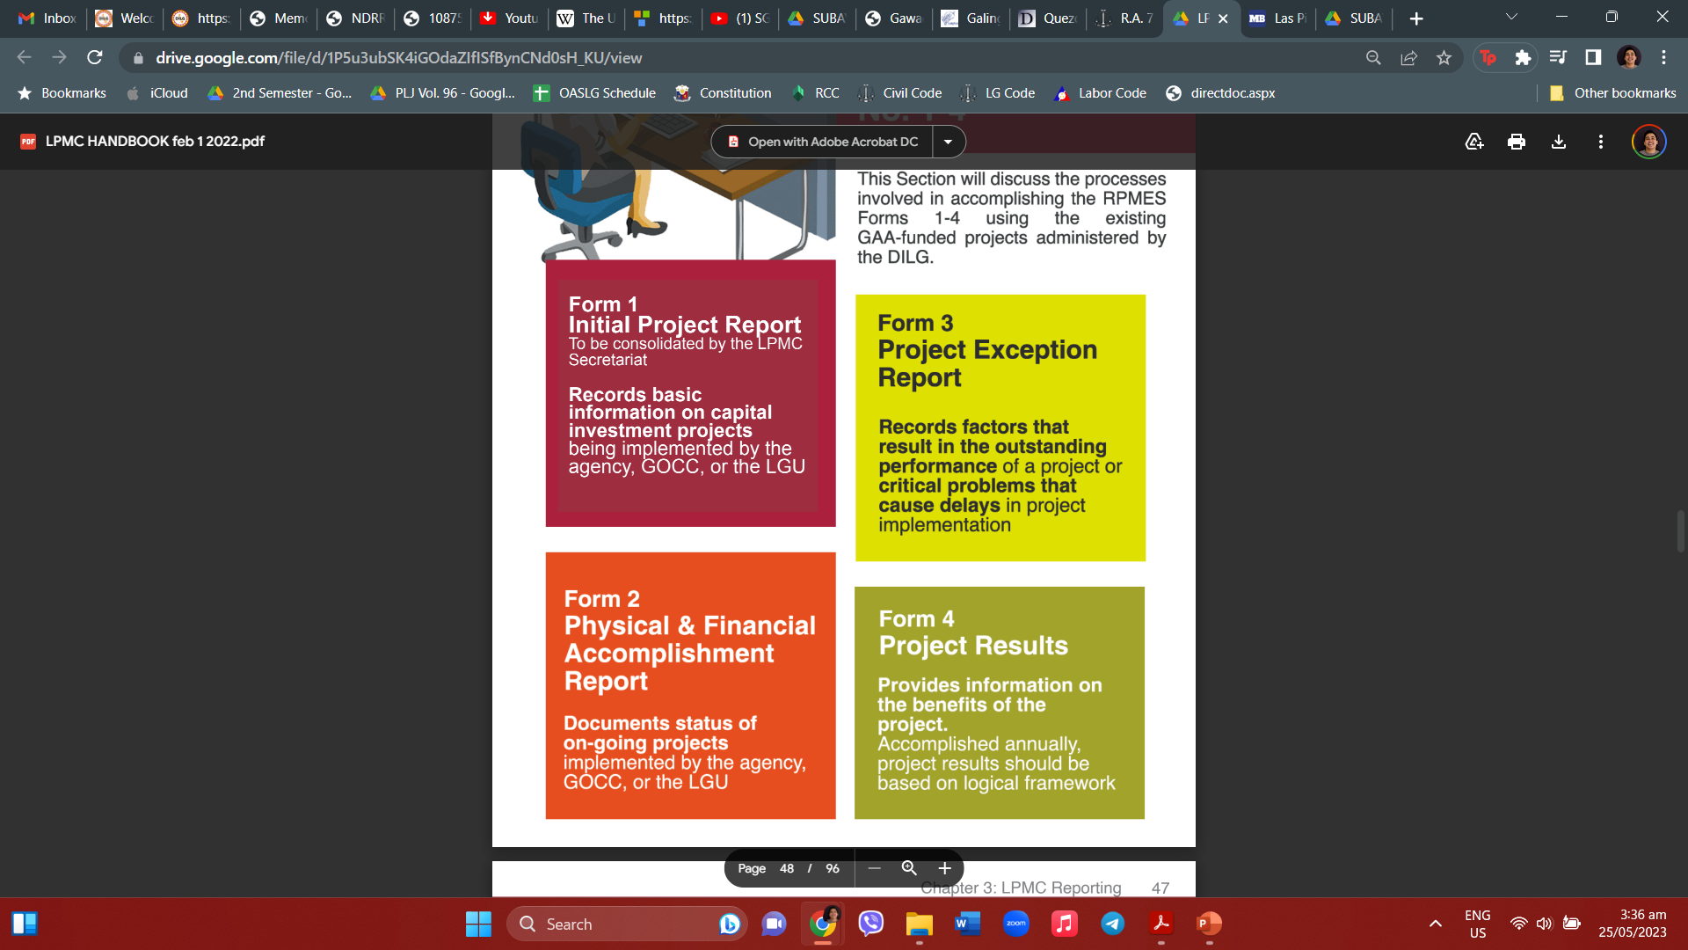
SubayBayani
The Project Monitoring and Evaluation System under SubayBayan.
Our LGU accountants are especially called on to assist LPMCs in the first two forms of the system.

Slide 17

Gawad Kalasag
Gawad Kalasag is the country’s recognition and award scheme for various stakeholders who promote disaster-risk reduction, climate change adaptation, and humanitarian assistance.
It allows local DRRM councils and offices to be assessed based on a self-assessment tool and a validation conducted by various agencies.

Slide 18
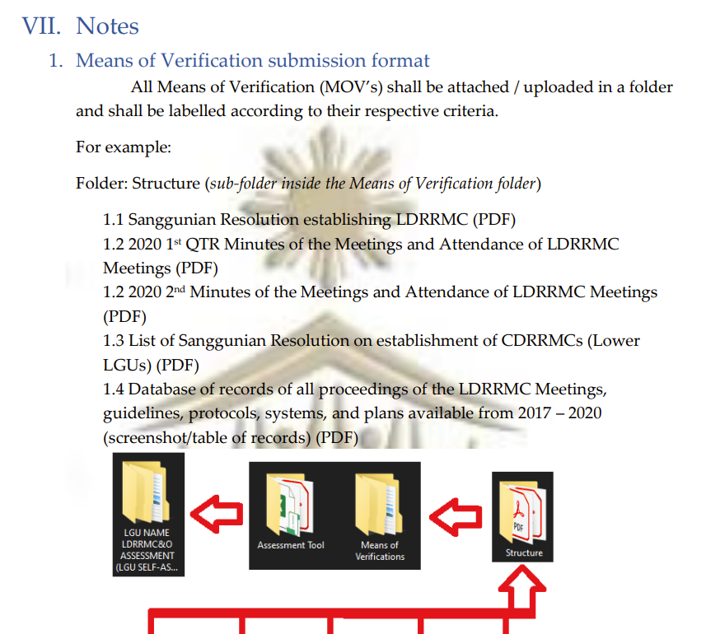
Gawad Kalasag
The Gawad Kalasag assessment and validation process entails the submission of various MOVs on the operation of local DRRM councils and offices.
These may include financial reports, minutes of meetings, and other similar documents.

Slide 19
Recommendations
In analyzing how you can help your respective LGUs attain excellence in local governance – particularly in certain national government metrics – be guided by your pillars of DILIGENCE, TRANSPARENCY, and SYNERGY.
As local accountants, you hold the keys to accessing valuable resources of the LGU. This makes you very powerful stakeholders. Leverage this power to influence and help other operating units and organizations in your locality. Excellent local governance is a collective achievement!

Slide 20
Thank you!
Office of the Assistant Secretary for Local Government
Department of the Interior and Local Government

